Slide 1
Process Management Lesson 2

Slide 2
Outline
Programs and process concepts
􀂃 Multitasking
􀂃 The dispatcher
􀂃 Process scheduling
􀂃 Scheduling policies

Slide 3
Overview
A process is a program in execution. A process will need certain resources such as CPU time, memory, files, and I/O devices to accomplish its task.
These resources are typically allocated to the process while it is executing
Modern operating systems support processes having multiple threads of control.
On systems with multiple hardware processing cores, these threads can run in parallel. One of the most important aspects of an operating system is how it schedules threads onto available processing cores.

Slide 4
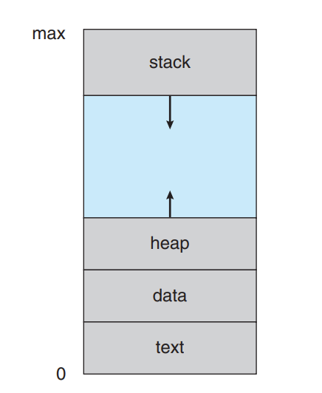
Process
When a program becomes a process (i.e., gets loaded into memory), the OS organizes its memory into four main sections.

Slide 5
Process
Text section— the executable code
Data section—global variables
Heap section—memory that is dynamically allocated during program run time
Stack section— temporary data storage when invoking functions (such as function parameters, return addresses, and local variables)

Slide 6
How Stack and Heap Behave Dynamically
While the Text and Data sections remain constant once loaded, the Stack and Heap are dynamic — they grow and shrink as the program executes.
The “grow” and “shrink” don’t mean the physical RAM expands like a balloon. They mean that the portion of the process’s memory space currently being used for those purposes increases or decreases.
Each time a function is called, an activation record containing function parameters, local variables, and the return address is pushed onto the stack; when control is returned from the function, the activation record is popped from the stack

Slide 7
How Stack and Heap Behave Dynamically
Similarly, the heap will grow as memory is dynamically allocated, and will shrink when memory is returned to the system.
Although the stack and heap sections grow toward one another, the operating system must ensure they do not overlap one another.

Slide 8
How Stack and Heap Behave Dynamically
In reality: Stack growth means: The stack pointer register moves downward, claiming more of the process’s address space.
Heap growth means: The heap end pointer moves upward, reserving more of the process’s address space.
They don’t physically push each other — the OS simply tracks how much of the available space between them is being used.

Slide 9
Process State
As a process executes, it changes state. The state of a process is defined in part by the current activity of that process. A process may be in one of the following states:
New. The process is being created.
Running. Instructions are being executed.
Waiting. The process is waiting for some event to occur (such as an I/O completion or reception of a signal).
Ready. The process is waiting to be assigned to a processor.
Terminated. The process has finished execution.

Slide 10
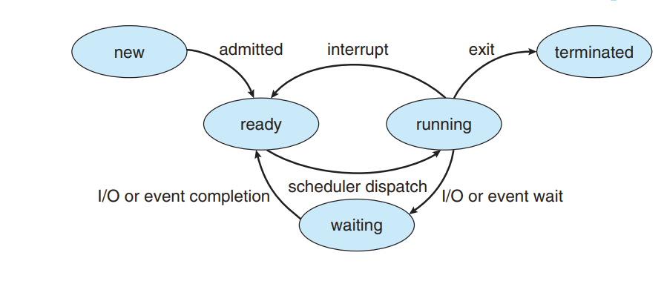
Diagrammatic Representation of the states

Slide 11
Process State
These state names do vary across operating systems. The states that they represent are found on all systems, however.
It is important to realize that only one process can be running on any processor core at any instant. Many processes may be ready and waiting, however.

Slide 12
Process Control Block
Each process is represented in the operating system by a process control block (PCB)—also called a task control block.
In brief, the PCB simply serves as the repository for all the data needed to start, or restart, a process, along with some accounting data.

Slide 13
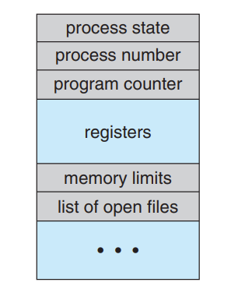
Process Control Block
A PCB contains many pieces of information associated with a specific process, including these:.

Slide 14
Process Control Block
Process state. The state may be new, ready, running, waiting, halted, and so on.
Program counter. The counter indicates the address of the next instruction to be executed for this process.
CPU registers. The registers vary in number and type, depending on the computer architecture. Along with the program counter, this state information must be saved when an interrupt occurs, to allow the process to be continued correctly afterward when it is rescheduled to run.
CPU-scheduling information. This information includes a process priority, pointers to scheduling queues, and any other scheduling parameters.

Slide 15
Process Control Block
Memory-management information. This information may include such items as the value of the base and limit registers and the page tables, or the segment tables, depending on the memory system used by the operating system.
Accounting information. This information includes the amount of CPU and real time used, time limits, account numbers, job or process numbers, and so on.
I/O status information. This information includes the list of I/O devices allocated to the process, a list of open files, and so on.

Slide 16
Threads
The process model discussed so far has implied that a process is a program that performs a single thread of execution.
This single thread of control allows the process to perform only one task at a time.
For example, when a process is running a word-processor program, a single thread of instructions is being executed. Thus, the user cannot simultaneously type in characters and run the spell checker.

Slide 17
Threads
Most modern operating systems have extended the process concept to allow a process to have multiple threads of execution and thus to perform more than one task at a time.
This feature is especially beneficial on multicore systems, where multiple threads can run in parallel.
A multithreaded word processor could, for example, assign one thread to manage user input while another thread runs the spell checker. On systems that support threads, the PCB is expanded to include information for each thread. Other changes throughout the system are also needed to support threads.
Notes:
We will look at threads in details later in this course

Slide 18
Process Scheduling
Process scheduling is a crucial function of an operating system (OS) that determines which process runs next on the CPU.
In a modern multitasking environment, there are usually more processes ready to execute than there are CPU cores available.
The process scheduler ensures the CPU is efficiently utilized by deciding the order and duration for which each process runs.
Notes:
We will look at threads in details later in this course

Slide 19
Process Scheduling
The main goal of process scheduling is to:
Maximize CPU utilization (keep the processor busy).
Provide fairness so that every process gets a chance to execute.
Ensure responsiveness in interactive systems.
Maintain system stability and efficiency.
Notes:
We will look at threads in details later in this course

Slide 20
Process Scheduling
Objectives of Process Scheduling
There are two key objectives:
Multiprogramming Objective – to have as many processes as possible in memory so that some process is always ready to run.
Time-sharing Objective – to switch between processes rapidly, giving the illusion that all are running simultaneously.
In short: multiprogramming maximizes throughput, while time-sharing improves responsiveness.
Notes:
We will look at threads in details later in this course

Slide 21
Process Scheduling
Understanding Processes and CPU Cores
Each CPU core can handle only one process at a time.
In a single-core system, only one process runs, and others wait in a queue.
In a multi-core system, multiple processes can run in parallel — one per core.
However, when there are more processes than cores, some must wait. The OS manages these waiting processes through scheduling queues.
The degree of multiprogramming refers to how many processes are currently in memory and competing for CPU time.
Notes:
We will look at threads in details later in this course

Slide 22
Process Scheduling
Types of Processes: I/O-bound vs CPU-bound
Understanding process behavior helps the scheduler make good decisions.
A good scheduler must balance between the two so the CPU is never idle — while one process waits for I/O, another (CPU-bound) process should use the CPU.
Type | Description | Example
I/O-bound | Spends most time waiting for I/O operations (keyboard, disk, network). | Word processor, web browser.
CPU-bound | Spends most time performing calculations and logic. | Video encoding, scientific simulations.
Notes:
We will look at threads in details later in this course

Slide 23
Scheduling Queues
When a process enters the system, it passes through several queues:
Ready Queue – holds processes waiting to use the CPU.
Typically stored as a linked list.(processes are stored as nodes of the linked list)
Each node is a Process Control Block (PCB) that stores process details (state, registers, memory info, etc.).
Wait Queue – holds processes waiting for a specific event, like completion of I/O or a child process.
Job Queue – contains all processes in the system (ready, waiting, etc.).
Queueing Diagram Example:
Notes:
We will look at threads in details later in this course

Slide 24
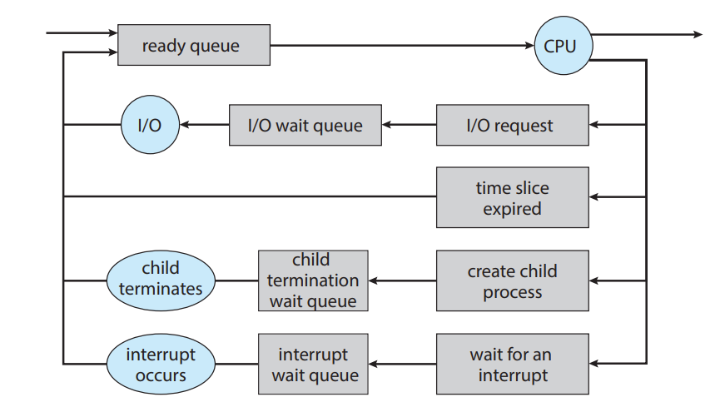
Queueing Diagram Example
Notes:
We will look at threads in details later in this course

Slide 25
Scheduling Queues
Once the process is allocated a CPU core and is executing, one of several events could occur:
The process could issue an I/O request and then be placed in an I/O wait queue.
• The process could create a new child process and then be placed in a wait queue while it awaits the child’s termination.
• The process could be removed forcibly from the core, as a result of an interrupt or having its time slice expire, and be put back in the ready queue.
In the first two cases, the process eventually switches from the waiting state to the ready state and is then put back in the ready queue. A process continues this cycle until it terminates, at which time it is removed from all queues and has its PCB and resources deallocated
Notes:
We will look at threads in details later in this course

Slide 26
CPU Scheduling
Processes move between the ready queue and I/O wait queues during execution.
The CPU scheduler selects one process from the ready queue and assigns it to a CPU core.
I/O-bound processes:
Run briefly, then wait for I/O.
CPU-bound processes:
Need the CPU longer, but are periodically pre-empted to ensure fairness.
The scheduler typically runs every few milliseconds (often < 100 ms) to switch between processes.
When a process finishes, it is removed from all queues, and its resources are released.
Notes:
We will look at threads in details later in this course

Slide 27
CPU Scheduling
Purpose of CPU Scheduling
In a multiprogrammed system, multiple processes are waiting to use the CPU. Since only one process can use a core at a time, the scheduler ensures that:
The CPU is never idle while there are runnable processes.
Each process gets a fair share of processing time.
High-priority or time-sensitive processes (like user interactions) get quicker responses.
Scheduling decisions occur when a process:
Switches from running to waiting state (e.g., waits for I/O).
Switches from running to ready state (e.g., time slice expires).
Switches from waiting to ready state (e.g., I/O completes).
Terminates.
Notes:
We will look at threads in details later in this course

Slide 28
CPU Scheduling
Preemptive vs. Non-Preemptive Scheduling
Non-preemptive scheduling means that once a process is given the CPU, it runs to completion or until it voluntarily releases the CPU (e.g., for I/O). Example: First-Come, First-Served (FCFS) scheduling.
Preemptive scheduling allows the operating system to forcibly remove a running process from the CPU to give others a turn. Example: Round Robin or Priority Scheduling.
Preemptive scheduling improves responsiveness but requires mechanisms for interrupt handling and context switching.
Notes:
We will look at threads in details later in this course

Slide 29
Role of the Dispatcher
Once the scheduler decides which process will run next, the dispatcher carries out that decision. The dispatcher performs:
Context Switching — saves the state of the current process and loads the state of the next.
Switching to user mode — resumes execution in the correct mode (user vs. kernel).
Jumping to the correct location in the program to restart it.
The dispatcher latency is the time it takes to stop one process and start another. Minimizing this latency is key to maintaining a responsive system.
Notes:
We will look at threads in details later in this course

Slide 30
Swapping (Intermediate Scheduling)
Swapping is an intermediate scheduling mechanism that allows the operating system to move entire processes between main memory and secondary storage (like a hard disk). This helps control the number of processes in memory and maintain performance when system memory becomes overloaded.
When the degree of multiprogramming is too high (too many processes in memory), the OS may swap out a process — writing its memory contents to disk to free space — and swap in another process when needed.
Swapping Out: Process’s current memory image is saved to disk (suspended).
Swapping In: Process is brought back into memory and resumes execution.
Notes:
We will look at threads in details later in this course

Slide 31
How Swapping Works
OS chooses an idle or low-priority process to swap out.
It writes that process’s memory image (including code, data, and stack) to a swap file or swap partition on disk.
It loads another waiting process from disk into the freed memory.
Later, when the swapped-out process is needed, it is loaded back — continuing from where it left off.
Example
Suppose four processes (P1–P4) are ready, but RAM can only hold three. If P2 is idle (waiting for I/O), the OS can swap out P2 to disk and swap in P4. When P2’s I/O finishes, it can be swapped in again.
Notes:
We will look at threads in details later in this course

Slide 32
Swapping Trade-offs
Advantages: Improves CPU utilization and responsiveness.
Disadvantages: Disk I/O is slow; excessive swapping leads to thrashing (when the OS spends more time swapping than executing).
Modern operating systems like Linux still use swapping to some extent, managed dynamically through virtual memory paging.
Notes:
We will look at threads in details later in this course

Slide 33
What is Context?
Each process has a unique execution context, which represents its current state:
CPU register contents (accumulator, stack pointer, etc.)
Program counter (next instruction to execute)
Process state (running, waiting, ready)
Memory mapping info
Accounting information (CPU time, priority, etc.)
All this data is stored in the Process Control Block (PCB).
Switching the CPU core to another process requires performing a state save of the current process and a state restore of a different process. This task is known as a context switch
Notes:
We will look at threads in details later in this course

Slide 34
Context Switch
By now we know that ,interrupts cause the operating system to change a CPU core from its current task and to run a kernel routine.
Such operations happen frequently on general-purpose systems.
When an interrupt occurs, the system needs to save the current context of the process running on the CPU core so that it can restore that context when its processing is done, essentially suspending the process and then resuming it.
Notes:
We will look at threads in details later in this course

Slide 35
Context Switching
Switching the CPU core to another process requires performing a state save of the current process and a state restore of a different process. This task is known as a context switch
When a context switch occurs, the kernel saves the context of the old process in its PCB and loads the saved context of the new process scheduled to run. Context switch time is pure overhead, because the system does no useful work while switching.
Switching speed varies from machine to machine, depending on the memory speed, the number of registers that must be copied, and the existence of special instructions (such as a single instruction to load or store all registers).
A typical speed is a several microseconds.
Notes:
We will look at threads in details later in this course

Slide 36
Context Switching
Context-switch times are highly dependent on hardware support. For instance, some processors provide multiple sets of registers.
A context switch here simply requires changing the pointer to the current register set. Of course, if there are more active processes than there are register sets, the system resorts to copying register data to and from memory, as before.
Notes:
We will look at threads in details later in this course

Slide 37
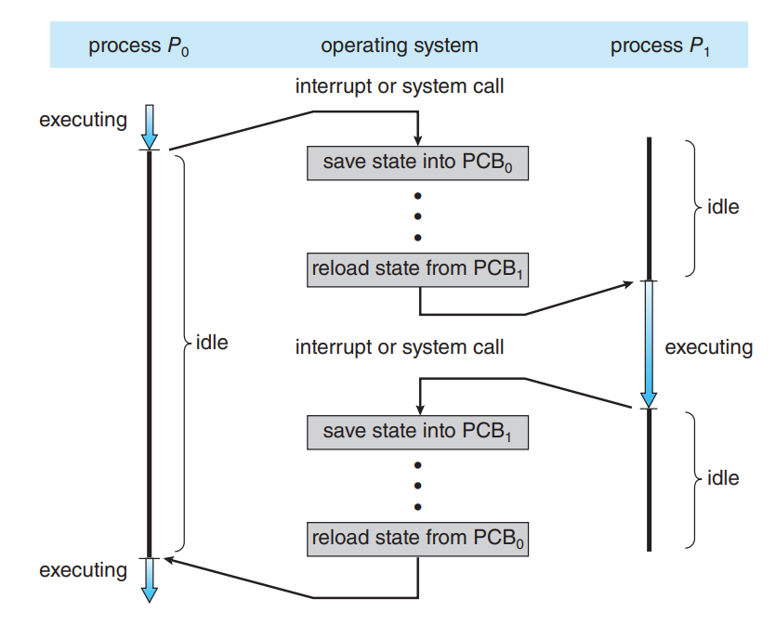
Context Switching
Notes:
We will look at threads in details later in this course

Slide 38
THANK YOU

